Slide 1
CS390 Lab 01
Class ID: 55

Slide 2
Table of Contents
Use Case Diagram ………………………………………………………………..3-13
Class Objects Diagram …………………………………………………………14-24
Context Data-Flow Diagram……………………………………………..........25-35
Level-0 Diagram …………………………………………………………………36-46
State Transition Diagram ……………………………………………………...47-57
Recommendations ……………………………………………………………….58-59

Slide 3
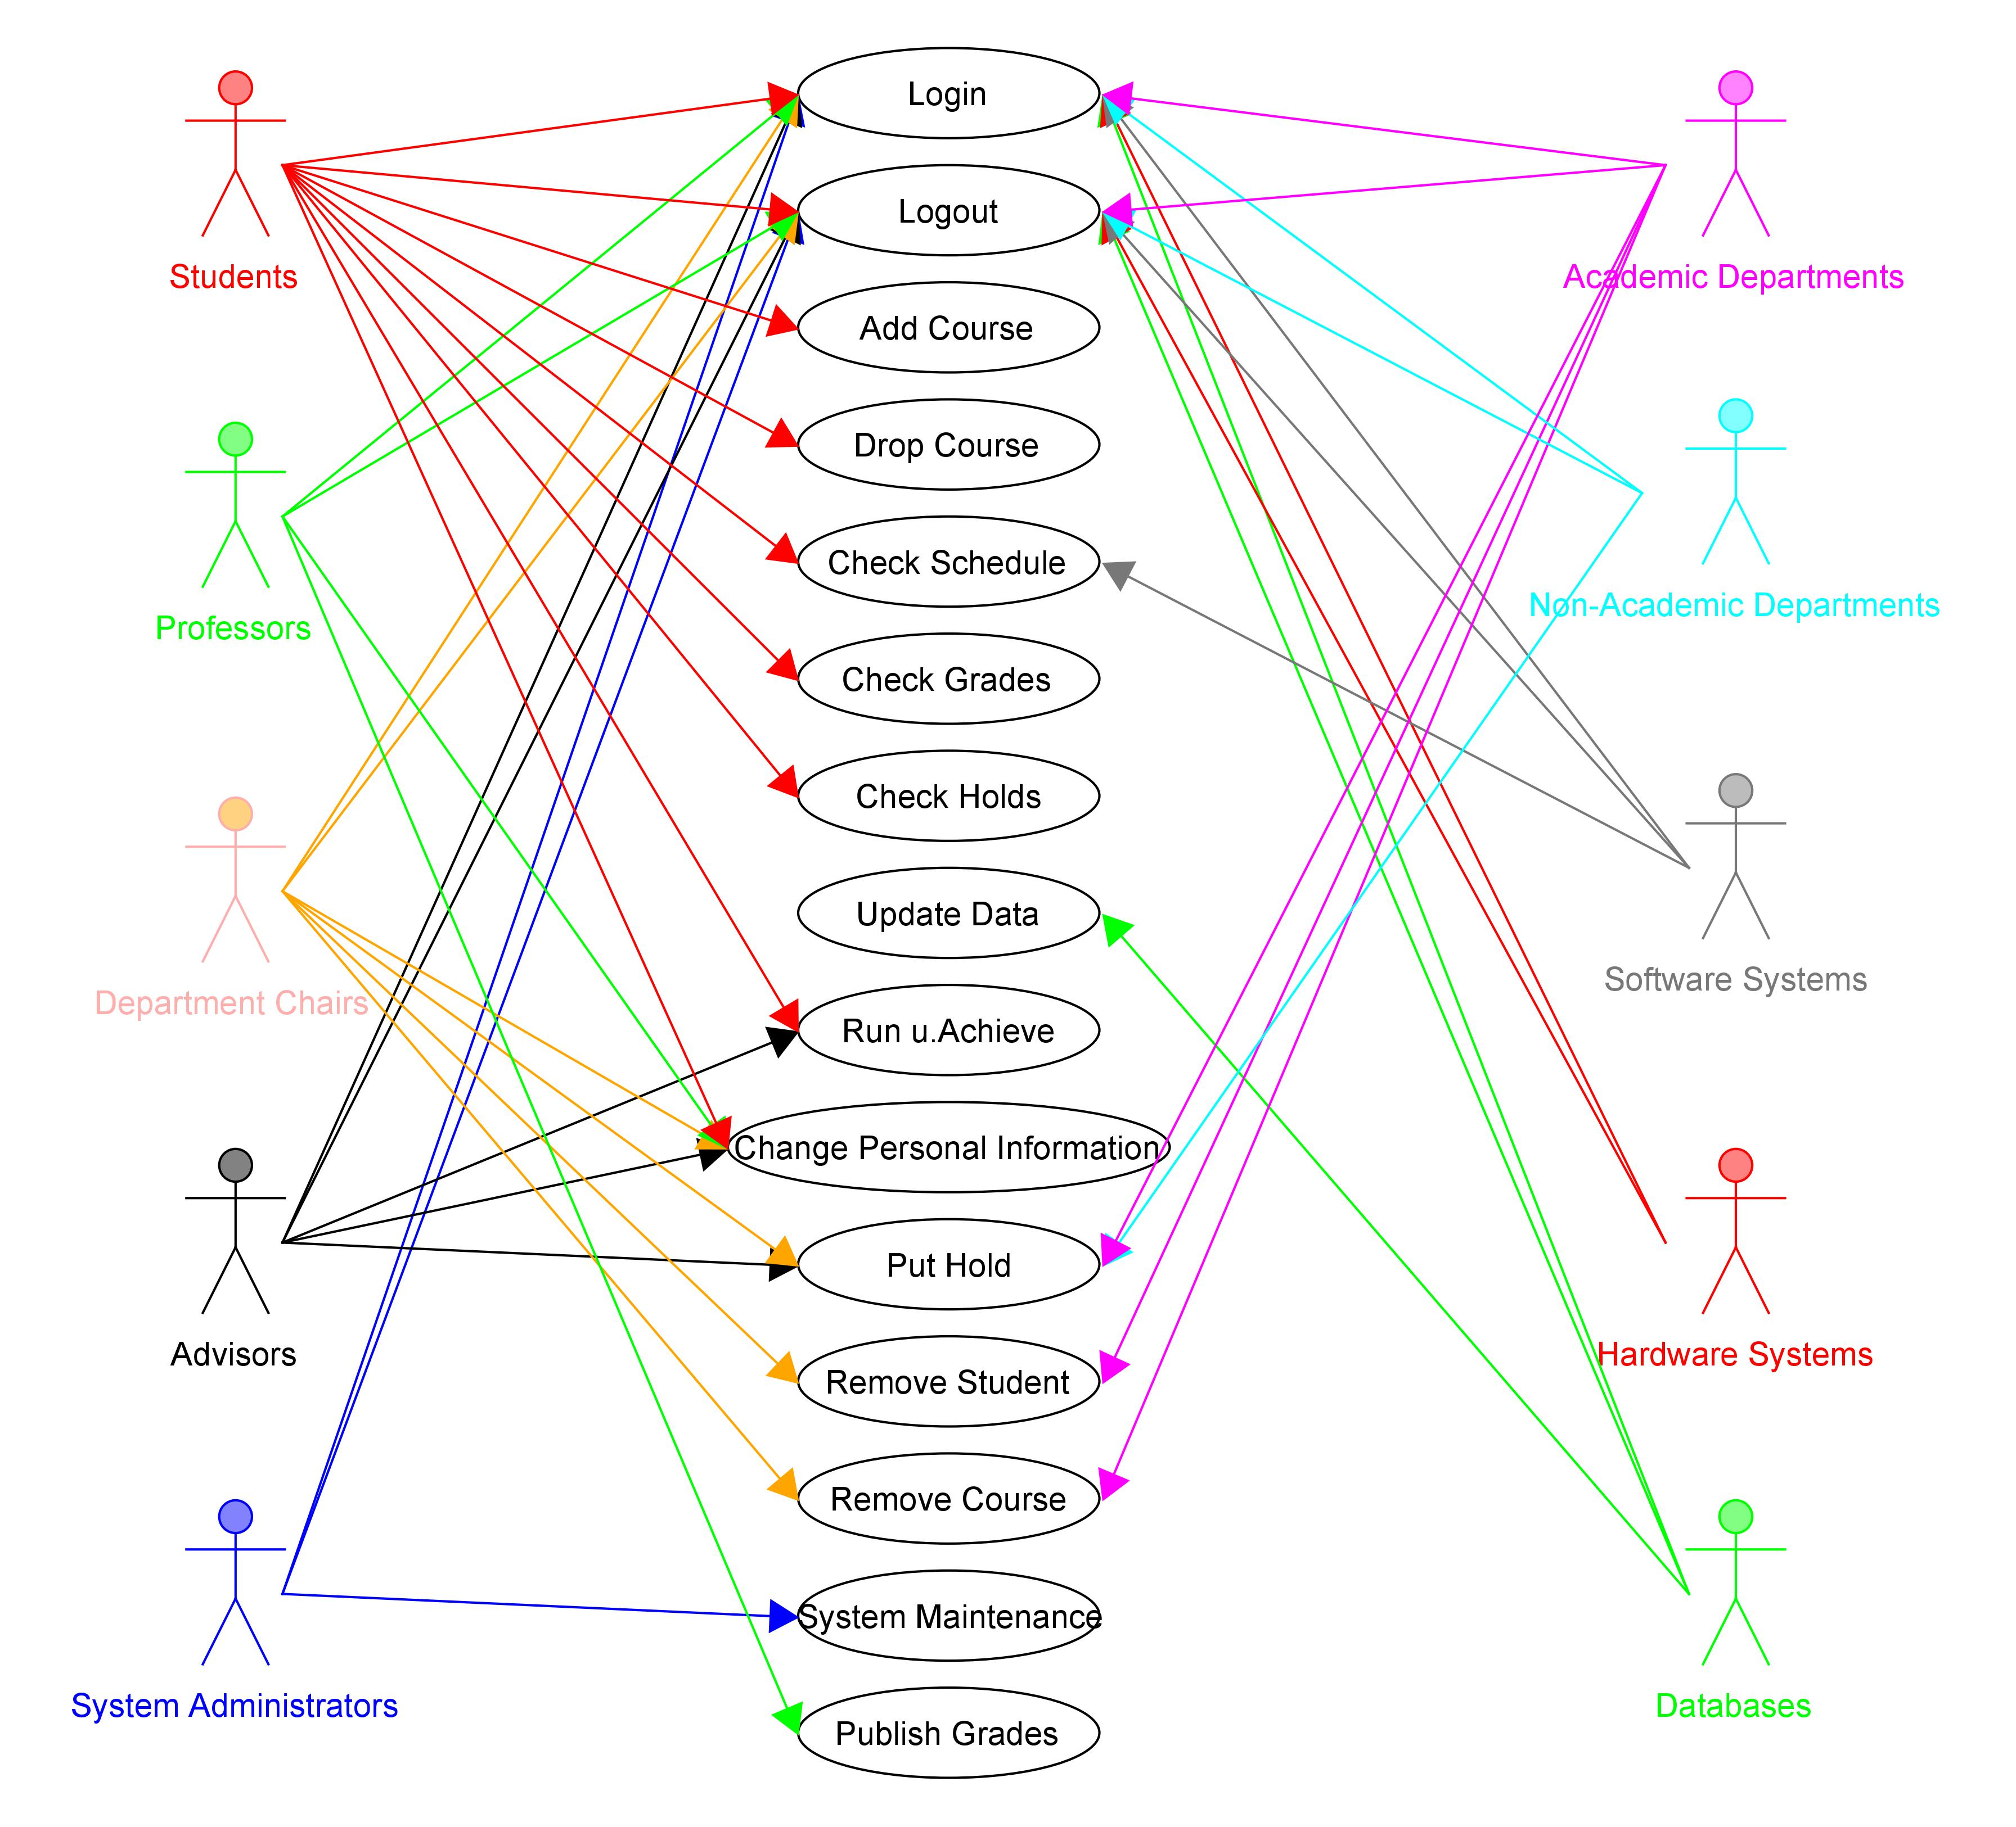
Diagram 1: Use Case
Human
Non-Human
Created with UMLet

Slide 4

Human Actors: Students
Use the following methods:
Login
Logout
Add Course
Drop Course
Check Schedule
Check Grades
Run u.Achieve
Change Personal Information

Slide 5
Human Actors: Professors
Use the following methods:
Login
Logout
Change Personal Information
Publish Grades

Slide 6
Human Actors: Department Chairs
Use the following methods:
Login
Logout
Change Personal Information
Put Hold
Remove Student
Remove Course

Slide 7
Human Actors: Advisors
Use the following methods:
Login
Logout
Run u.Achieve
Change Personal Information
Put Hold

Slide 8
Human Actors: System Administrators
Use the following methods:
Login
Logout
System Maintenance

Slide 9

Non-Human Actors: Academic Departments
Use the following methods:
Login
Logout
Put Hold
Remove Student
Remove Course

Slide 10
Non-Human Actors: Non-Academic Departments
Use the following methods:
Login
Logout
Put Hold

Slide 11
Non-Human Actors: Software System
Use the following methods:
Login
Logout
Check Schedule

Slide 12
Non-Human Actors: Hardware Systems
Use the following methods:
Login
Logout

Slide 13
Non-Human Actors: Databases
Use the following methods:
Login
Logout
Change Data

Slide 14
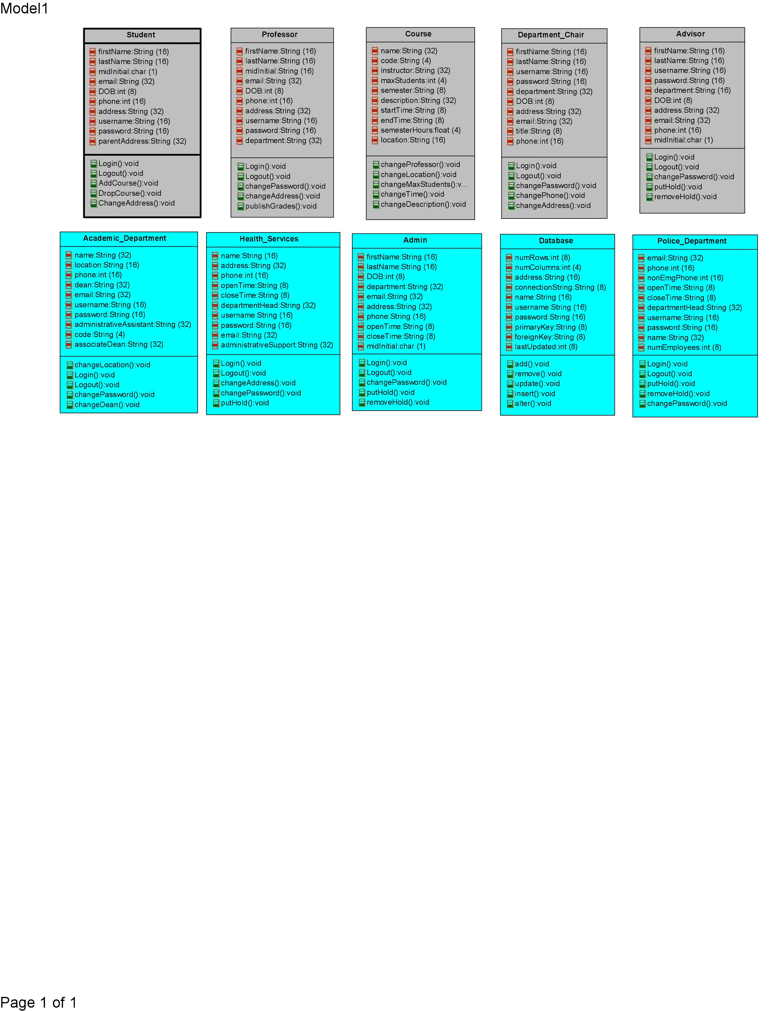
Diagram 2: Class Objects
Created with IBM Rational
Name
Attributes
Methods

Slide 15
Human Class Object: Student

Slide 16
Human Class Object: Professor

Slide 17
Human Class Object: Course

Slide 18
Human Class Object: Department Chair

Slide 19
Human Class Object: Advisor

Slide 20
Non-Human Class Object: Academic Department

Slide 21
Non-Human Class Object: Health Services

Slide 22
Non-Human Class Object: Administration

Slide 23
Non-Human Class Object: Database

Slide 24
Non-Human Class Object: Police Department

Slide 25
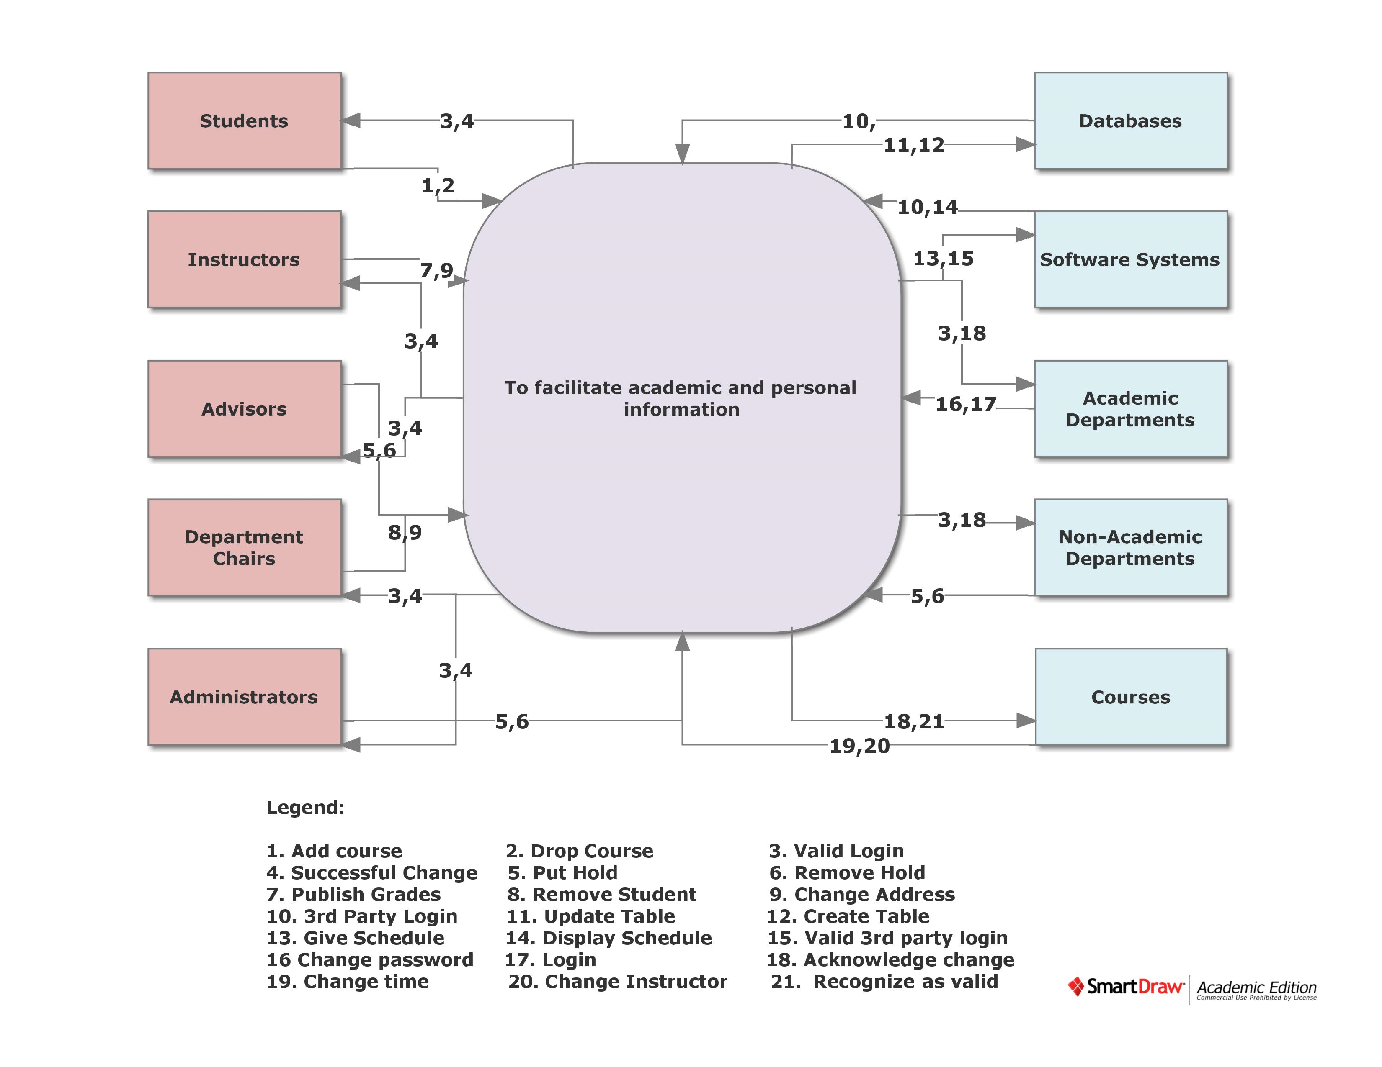
Diagram 3: Context Data-Flow
Created with SmartDraw

Slide 26

Human Entity: Students

Slide 27
Human Entity: Instructors

Slide 28
Human Entity: Advisors

Slide 29
Human Entity: Department Chairs

Slide 30
Human Entity: Administrators

Slide 31
Non-Human Entity: Databases

Slide 32
Non-Human Entity: Software Systems

Slide 33
Non-Human Entity: Academic Departments

Slide 34
Non-Human Entity: Non-Academic Departments

Slide 35
Non-Human Entity: Courses

Slide 36
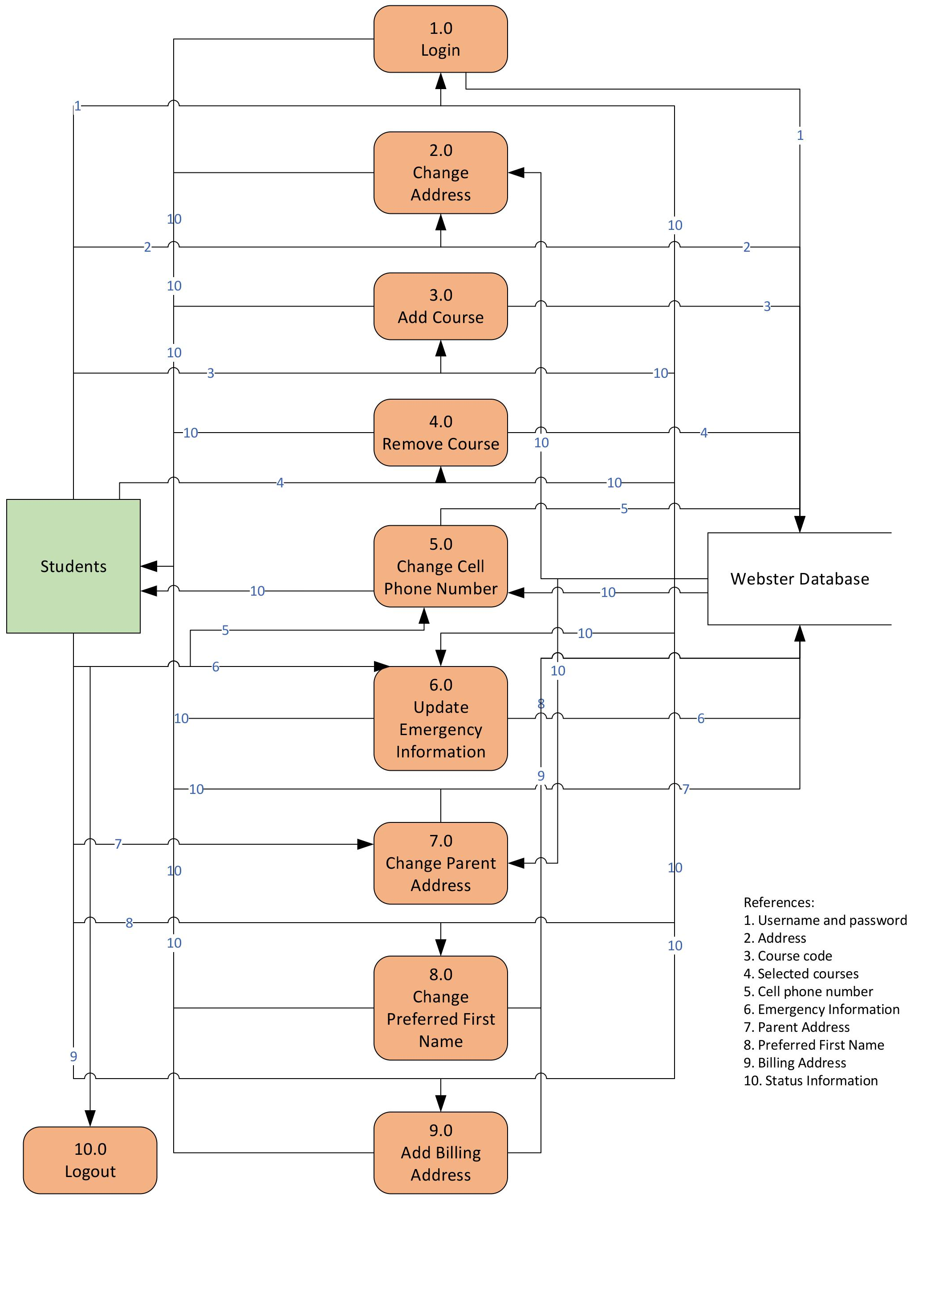
Diagram 4: Level-0
Process
Created with Microsoft Visio
Data Flow
Data Store
Interface

Slide 37
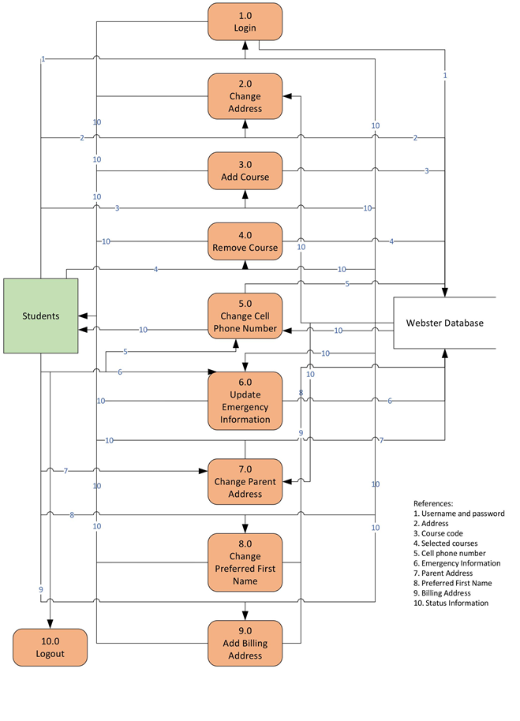
Process 1.0
From interface: 1
To data store: 1
From data store: 10
To interface: 10

Slide 38
Process 2.0
From interface: 2
To data store: 2
From data store: 10
To interface: 10

Slide 39
Process 3.0
From interface: 3
To data store: 3
From data store: 10
To interface: 10

Slide 40
Process 4.0
From interface: 4
To data store: 4
From data store: 10
To interface: 10

Slide 41
Process 5.0
From interface: 5
To data store: 5
From data store: 10
To interface: 10

Slide 42
Process 6.0
From interface: 6
To data store: 6
From data store: 10
To interface: 10

Slide 43
Process 7.0
From interface: 7
To data store: 7
From data store: 10
To interface: 10

Slide 44

Process 8.0
From interface: 8
To data store: 8
From data store: 10
To interface: 10

Slide 45
Process 9.0
From interface: 9
To data store: 9
From data store: 10
To interface: 10

Slide 46
Process 10.0
Logout Function: exits program

Slide 47
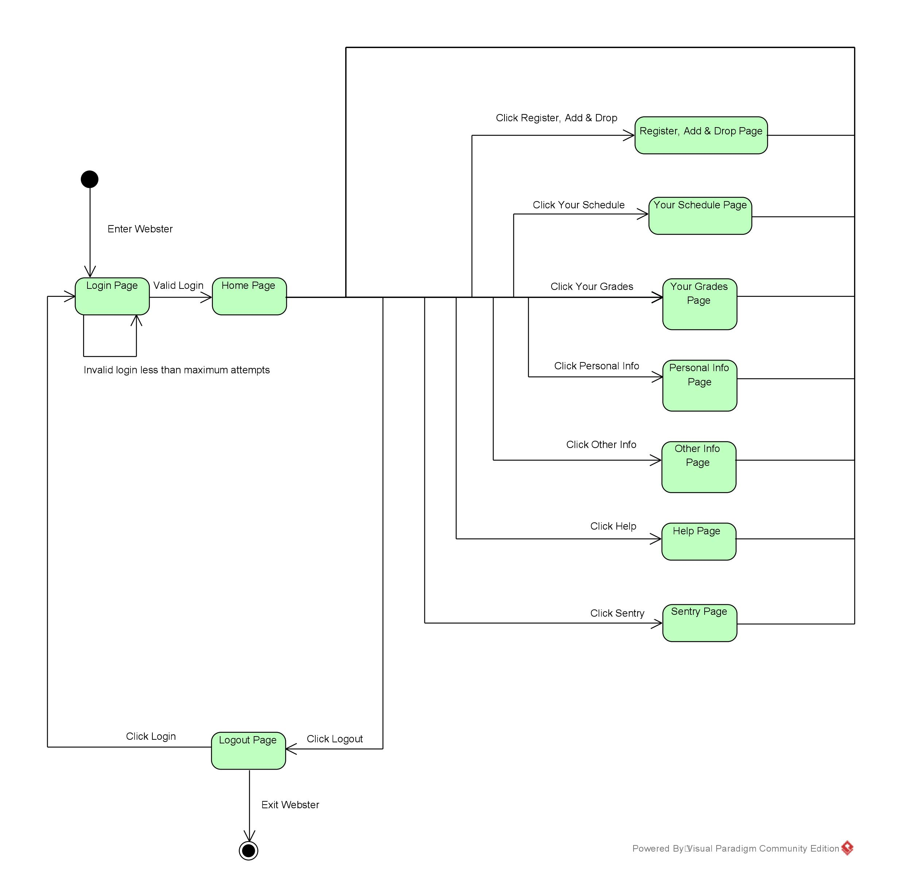
Diagram 5: State Transition
Created with Visual Paradigm

Slide 48
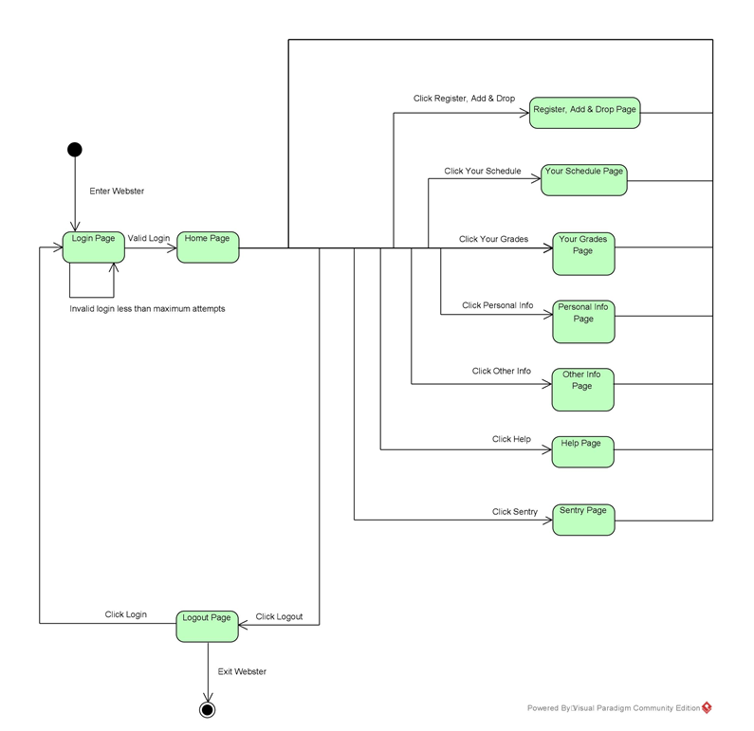
State: Login Page
Enter: By default, first page
Transition: Valid login causes state change

Slide 49
State: Home Page
Enter: Only enter by successful login
Transition: Clicking either Register, Add & Drop, Your Schedule, Your Grades, Personal Info, Other Info, Help, Sentry, or Logout

Slide 50
State: Register, Add & Drop
Enter: Clicking Register, Add & Drop
Transition: Clicking either Your Schedule, Your Grades, Personal Info, Other Info, Help, Sentry, or Logout

Slide 51
State: Your Schedule
Enter: Clicking Your Schedule
Transition: Clicking either Register, Add & Drop, Your Grades, Personal Info, Other Info, Help, Sentry, or Logout

Slide 52
State: Your Grades
Enter: Clicking Your Grades
Transition: Clicking either Register, Add & Drop, Your Schedule, Personal Info, Other Info, Help, Sentry, or Logout

Slide 53
State: Personal Info
Enter: Clicking Personal Info
Transition: Clicking either Register, Add & Drop, Your Schedule, Your Grades, Other Info, Help, Sentry, or Logout

Slide 54
State: Other Info
Enter: Clicking Other Info
Transition: Clicking either Register, Add & Drop, Your Schedule, Your Grades, Personal Info, Help, Sentry, or Logout

Slide 55
State: Help
Enter: Clicking Help
Transition: Clicking either Register, Add & Drop, Your Schedule, Your Grades, Personal Info, Other Info, Sentry, or Logout

Slide 56
State: Sentry
Enter: Clicking Sentry
Transition: Clicking either Register, Add & Drop, Your Schedule, Your Grades, Personal Info, Other Info, Help, or Logout

Slide 57
State: Logout
Enter: Clicking Logout
Transition: Either exit Webster, or Login

Slide 58
Recommendations
Use Case
UMLet
Paradigm
SmartDraw
Visio
Rational
Since the UCD is somewhat simple in what it needs, I prefer the simple UI’s over the more complex ones (which is why I put UMLet at 1).
Class Objects
SmartDraw
Visio
Rational
Paradigm
UMLet
In my opinion, the COD can be done in one CASE system just as easily as another. Since the SmartDraw and Visio UI’s seem more intuative to me, I ranked them higher.
Context Data-Flow
Paradigm
SmartDraw
Rational
UMLet
Visio
I found Paradigm to be the easiest to use diagramming tool when there was more complicated use of data movement. I also do not recommend Visio for this because I feel it is too restrictive.

Slide 59
Recommendations
Level-0
Paradigm
SmartDraw
Rational
UMLet
Visio
This ranking is identical to the CDF because they require similar components. The ones ranked lower felt either unintuitive or too restrictive.
State Transition
Paradigm
SmartDraw
Rational
UMLet
Visio
Again, this follows the same ranking as before. I feel that Paradigm is the most useful CASE system out of them all due to it’s ease of use. I again rank Visio and UMLet lowest because I find them to be less friendly to more complex diagrams

